Slide 1
Design and Analysis of Algorithm
UNIT-II
Greedy Algorithm
M Yogi Reddy
Assistant Professor,
Dept. of CSE,
School Of Technology,
GITAM(Deemed to be ) University,
Hyderabad.

Slide 2

Contents
Job Sequencing Algorithm
Knapsack Problem
Optimal storage on tapes [Huffman coding]
Minimum cost spanning trees
Single source shortest paths
1
2
3
4
5

Slide 3
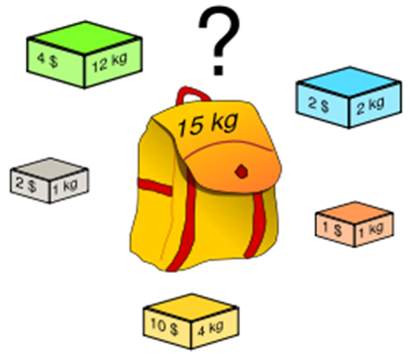
Knapsack Problem
The knapsack problem derives its name from the maximization problem of the best choice of essentials that can fit into one bag to be carried on a trip.
Given a set of items, each with a weight and a value, determine the number of each item to include in a collection so that the total weight is less than a given limit and the total value is as large as possible.

Slide 4
Knapsack Problem
Problem Definition
Want to carry essential items in one bag
Given a set of items, each has
A cost (i.e., 12kg)
A value (i.e., 4$)
Goal
To determine the number of each item to include in a collection so that
The total cost is less than some given cost
And the total value is as large as possible

Slide 5
The Original Knapsack Problem
Three Types
0/1 Knapsack Problem
Restricts the number of each kind of item to zero or one
Bounded Knapsack Problem
Restricts the number of each item to a specific value
Unbounded Knapsack Problem
Places no bounds on the number of each item

Slide 6




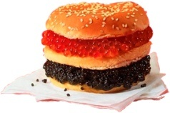
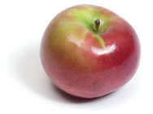
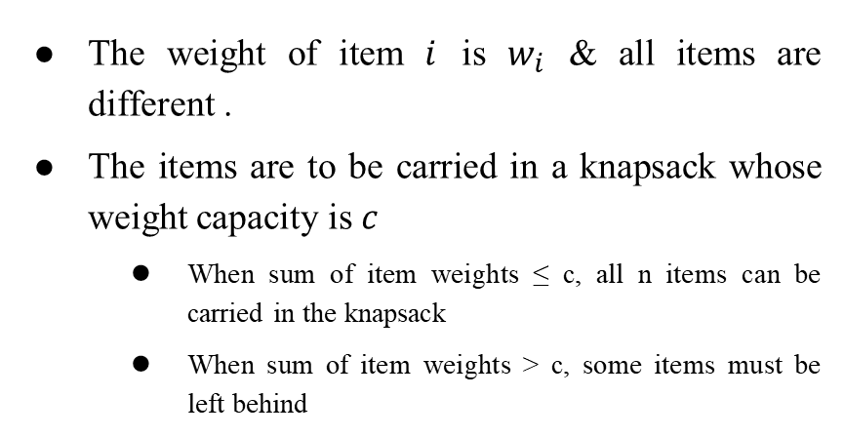
Knapsack Problem
Problem: One of your faculty is going on a trip and he wish to take $n$ items on a trip
The weight of item $i$ is $w_{i}$ & all items are different .
The items are to be carried in a knapsack whose weight capacity is $c$
When sum of item weights ≤ c, all n items can be carried in the knapsack
When sum of item weights > c, some items must be left behind

Slide 7
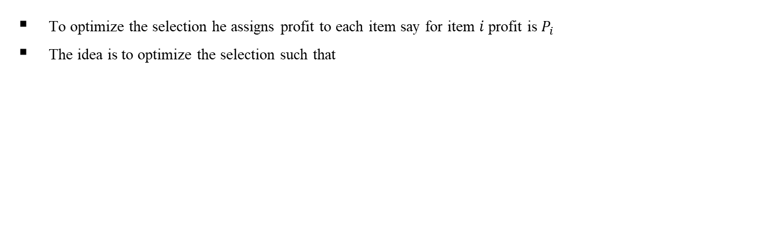
Knapsack Problem
Problem: One of your faculty is going on a trip and he wish to take $n$ items on a trip
To optimize the selection he assigns profit to each item say for item $i$profit is$P_{i}$
The idea is to optimize the selection such that
The profit of the subset is the sum of the profits of the selected items (optimization function)
The profit of the selected subset should be maximum (optimization criterion)
The weight of the subset does not exceed the capacity of the knapsack (constraint)
Cannot select a fraction of an item (constraint)

Slide 8
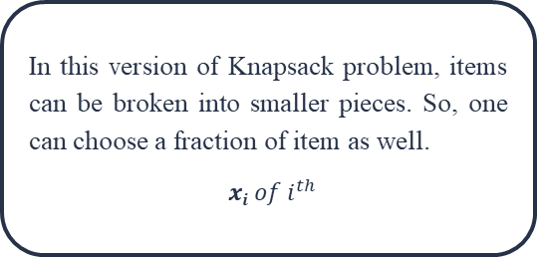
Fractional Knapsack
Given a set of items, each with a weight and a value, determine a subset of items to include in a collection so that the total weight is less than or equal to a given limit and the total value is as large as possible.
According to the problem statement,
There are n items in the store
Weight of $i^{th}$item $w_{i}>0$
Weight of 𝑖^𝑡ℎitem 𝑤_𝑖>0
Profit for $i^{th}$ item $pi>0$ and
Profit for 𝑖^𝑡ℎ item 𝑝𝑖>0 and
Capacity of the Knapsack is W
In this version of Knapsack problem, items can be broken into smaller pieces. So, one can choose a fraction of item as well.
$xi of i^{th}$
The$i^{th}$ item contributes the weight $x_{i}, w_{i}$ to the total weight in the knapsack and profit $x_{i}.p_{i}$ to the total profit.

Slide 9
Fractional Knapsack Problem
In fractional knapsack problem,
we are given a set S of$n$items,
we are given a set S of 𝑛 items,
each item $I$ has a positive benefit $p_{i}$ and
each item 𝐼 has a positive benefit 𝑝_𝑖 and
a positive weight $w_{i}$,
a positive weight 𝑤_𝑖,
we wish to find the maximum-benefit subset that doesn’t exceed a given weight $W$.

Slide 10
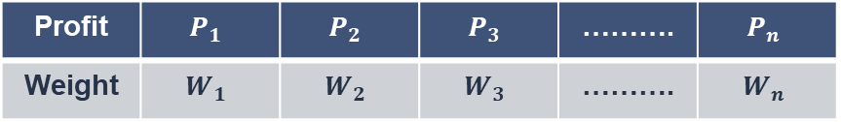

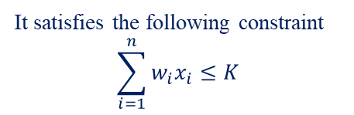
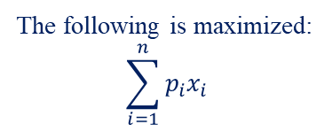
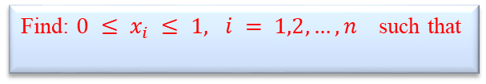
The Fractional Knapsack Problem: Formal Deﬁnition
Profit | $$P_{1}$$ | $$P_{2}$$ | $$P_{3}$$ | ………. | $$P_{n}$$
Weight | $$W_{1}$$ | $$W_{2}$$ | $$W_{3}$$ | ………. | $$W_{n}$$
Given$K$and a set of $n$ items
Find: $0 ≤ x_{i} ≤ 1, i = 1,2,…,n$such that
The following is maximized:
$$\sum_{i=1}^{n}{p_{i}x_{i}}$$
It satisfies the following constraint
$$\sum_{i=1}^{n}{w_{i}x_{i}≤K}$$
Objective Function
Constraints

Slide 11
The Fractional Knapsack Problem: Solution
There are three different strategies possible to find optimal solution for knapsack problem
Greedy about profit
Greedy about weight
Greedy about both profit and weight

Slide 12
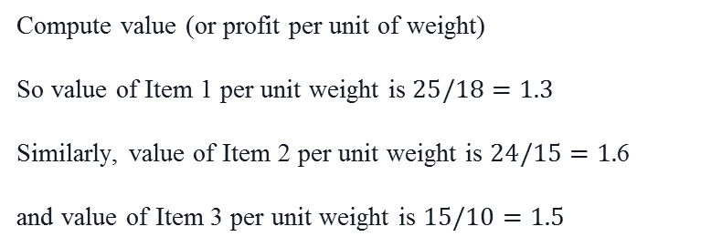
Greedy about both profit and weight
Item | Weight | profit
1 | 18 | 25
2 | 15 | 24
3 | 10 | 15
Compute value (or profit per unit of weight)
So value of Item 1 per unit weight is $25/18=1.3$
Similarly, value of Item 2 per unit weight is $24/15=1.$6
and value of Item 3 per unit weight is $15/10=1.5$

Slide 13
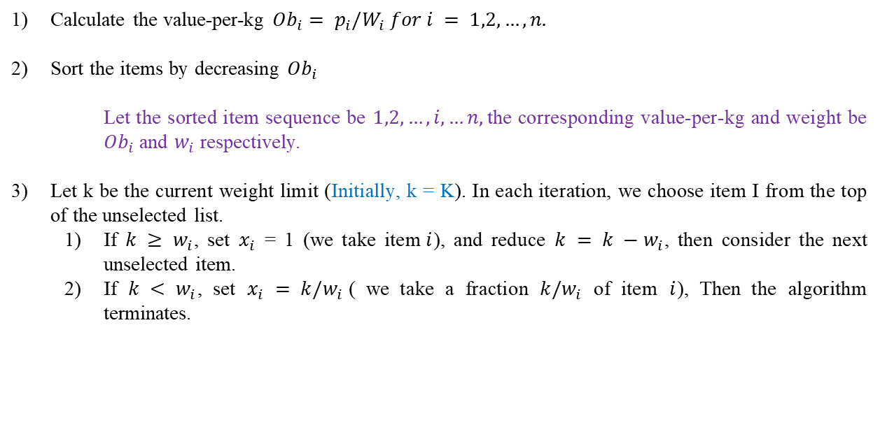
Calculation
Calculate the value-per-kg ${Ob}_{i}= p_{i}{/W}_{i} for i = 1,2,…,n.$
Sort the items by decreasing ${Ob}_{i}$
Let the sorted item sequence be $1,2,…,i,…n,$the corresponding value-per-kg and weight be ${Ob}_{i}$ and $w_{i}$ respectively.
Let k be the current weight limit (Initially, k = K). In each iteration, we choose item I from the top of the unselected list.
If $k ≥ w_{i}$, set $x_{i}$ = 1 (we take item$i$), and reduce $k = k −w_{i}$, then consider the next unselected item.
If $k < w_{i}$, set $x_{i} = k/w_{i}$( we take a fraction $k/w_{i}$ of item $i$), Then the algorithm terminates.

Slide 14
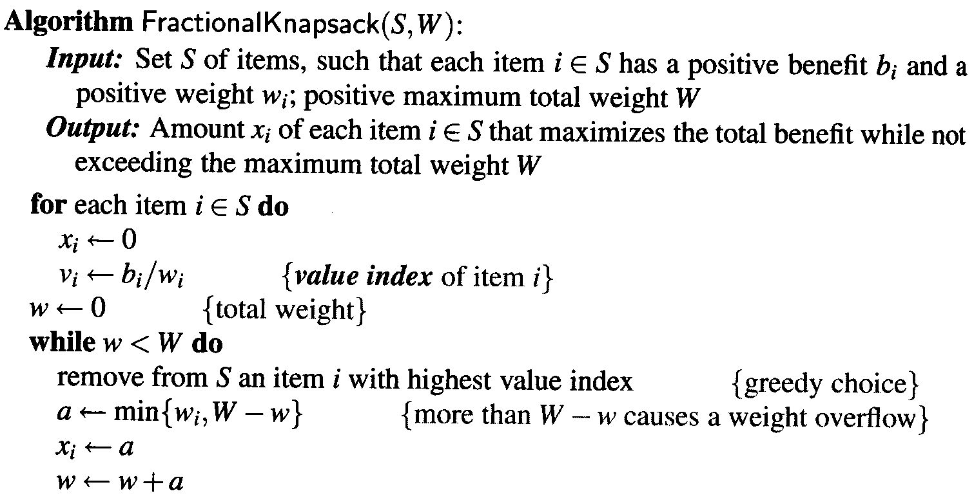
Fractional Knapsack Algorithm

Slide 15
Observation
Observe that the algorithm may take a fraction of an item.
This can only be the last selected item.
We claim that the total value for this set of items is the optimal value.

Slide 16
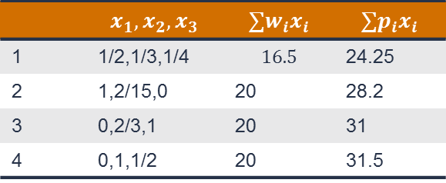
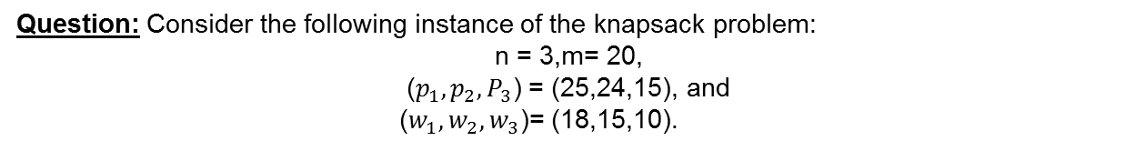
Feasible and Optimal solution
A feasible solution is any set ${(x}_{1} , x_{2}, x_{3}, ……..x_{n})$which satisfies the constraint.
A feasible solution is any set 〖(𝑥〗_1 , 𝑥_2, 𝑥_3, ……..𝑥_𝑛) which satisfies the constraint.
An optimal solution is a feasible solution for which the objective function is maximized.
Question: Consider the following instance of the knapsack problem:
n = 3,m= 20,
($p_{1},p_{2},P_{3}$) = (25,24,15), and
($w_{1},w_{2},w_{3}$)= (18,15,10).
Four feasible solutions are
 | $$x_{1}, x_{2},x_{3}$$ | $$∑w_{i}x_{i}$$ | $$∑p_{i}x_{i}$$
1 | 1/2,1/3,1/4 | $$16.5$$ | 24.25
2 | 1,2/15,0 | 20 | 28.2
3 | 0,2/3,1 | 20 | 31
4 | 0,1,1/2 | 20 | 31.5

Slide 17
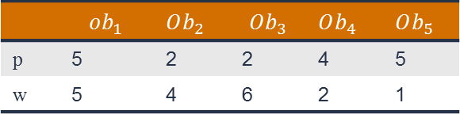

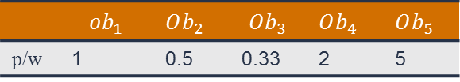
Question
Question: Consider the following instance of the knapsack problem. The max capacity of knapsack is 12
 | $$ob_{1}$$ | $Ob_{2}$ | $$Ob_{3}$$ | $Ob_{4}$ | $Ob_{5}$
p | 5 | 2 | 2 | 4 | 5
w | 5 | 4 | 6 | 2 | 1
Compute profit per unit weight for each object.
 | $$ob_{1}$$ | $Ob_{2}$ | $$Ob_{3}$$ | $Ob_{4}$ | $Ob_{5}$
p/w | 1 | 0.5 | 0.33 | 2 | 5
$$solution 1,1,0,1,1$$

Slide 18
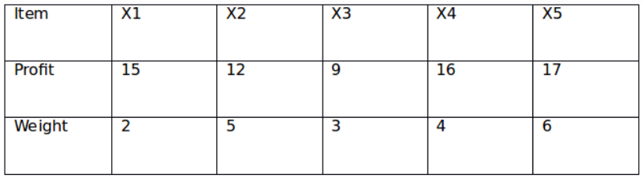
Question
Question: Consider the following instance of the knapsack problem:
The maximum weight of 12 is allowed in the knapsack.
Find the value of maximum profit with the optimal solution of the fractional knapsack problem.

Slide 19
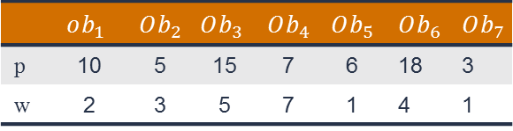
Question
Question: Consider the following instance of the knapsack problem:
 | $$ob_{1}$$ | $Ob_{2}$ | $$Ob_{3}$$ | $Ob_{4}$ | $Ob_{5}$ | $$Ob_{6}$$ | $$Ob_{7}$$
p | 10 | 5 | 15 | 7 | 6 | 18 | 3
w | 2 | 3 | 5 | 7 | 1 | 4 | 1
The maximum weight of 15 is allowed in the knapsack.

Slide 20
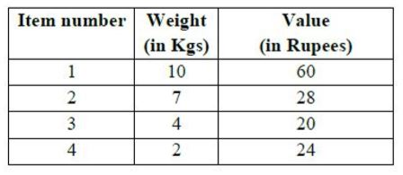
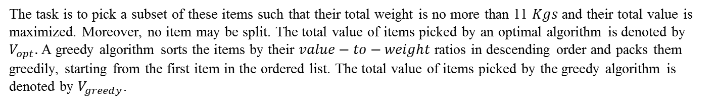
Assignment Question
Question: Consider the weights and values of items listed below. Note that there is only one unit of each item.
The task is to pick a subset of these items such that their total weight is no more than 11 $Kgs$ and their total value is maximized. Moreover, no item may be split. The total value of items picked by an optimal algorithm is denoted by $V_{opt}.$A greedy algorithm sorts the items by their $value−to−weight$ratios in descending order and packs them greedily, starting from the first item in the ordered list. The total value of items picked by the greedy algorithm is denoted by $V_{greedy}$.

Slide 21
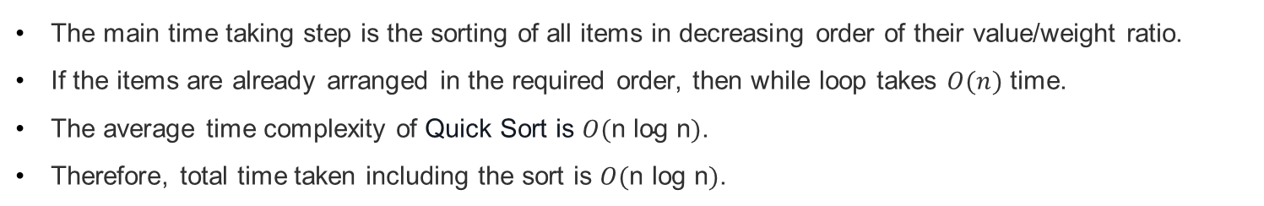
Time Complexity
The main time taking step is the sorting of all items in decreasing order of their value/weight ratio.
If the items are already arranged in the required order, then while loop takes $O(n)$ time.
The average time complexity of Quick Sort is $O(\text{n} \text{log} \text{n})$.
Therefore, total time taken including the sort is $O(\text{n} \text{log} \text{n})$.

Slide 22
Knapsack Problem
Lemma 1. In case the sum of all the weights is $< m$, then $x_{i}= 1, 1≤i≤n$is an optimal solution
Lemma 2. All optimal solutions will fill the knapsack exactly

Slide 23



